Slide 1
Safety and Loss Control
<Insert Presenter Information Here>

Slide 2
Differing points of view...
“It’s a dangerous job. If you’re not getting hurt, you must not be doing much work.”
“You can’t do that, it’s not safe.”
“It may be a dangerous job, but let’s find a way to do it without getting hurt.”

Slide 3
What Are We Talking About?
Safety: Identifying, assessing, and eliminating or controlling workplace hazards.
Safety: The condition of not having to undergo any loss, damage or injury.
Loss Control: Efforts taken to minimize the frequency and severity of a losses, damages or injuries that cannot be eliminated.

Slide 4
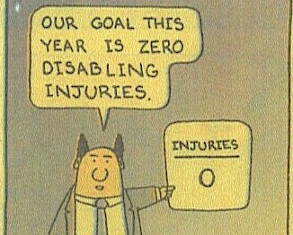
Why the goal has to be zero
Notes:
Some people say that not having ANY accidents or injuries is impossible. Raise your hand if you have never had to file a Workers’ Compensation claim. We just witnessed the impossible! I know of people who have worked 30 and 40 years without having an accident – and they fought fire for a living! The “zero goal” may be a difficult one to attain, but it is possible. Instead of looking at your entire workforce covering an entire year, try bringing it down to an individual level. How many people that work with you or for you had no reportable accidents last year? If they could do it, why can’t their co-workers? Those people working through the year with no accidents or injuries have proven it could be done. For some people, a one month at a time, or week or day may be more suitable. Now, for some jobs, the “zero goal” may not seem realistic. Some jobs are inherently dangerous such as law enforcement, fire protection, agriculture, what are some others… For these jobs, the goal is very difficult to attain. It may not be attained in our lifetimes – but zero still needs to be the target – would you volunteer to get hurt to attain any other goal?

Slide 5
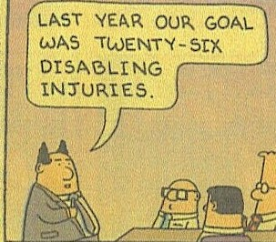

Slide 6
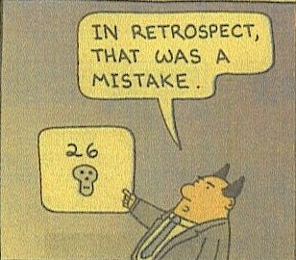

Slide 7
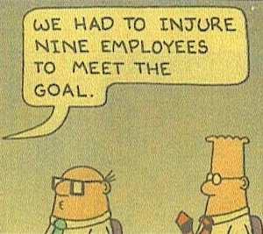

Slide 8
Identifying Hazards
Data Analysis
Workers’ Compensation
General Liability
Professional Liability
Auto Liability
Guides to who, what, when, where, how loss, damage and injury is occurring.

Slide 9
Identifying Hazards
On-site Assessment
Based on data analysis
Based on high risk potential
Based on schedule, standards or accreditation
Based on request
Communication with employees and supervisors, educational, consensus on strategies.

Slide 10
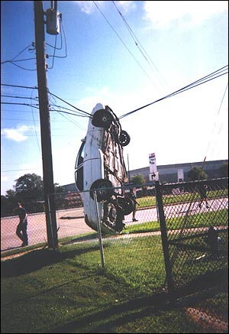
Identifying Hazards
Accident / Injury Investigation
Methodical
Documented
Objective
Fact Finding
Learn from experience
Use to prevent similar events in the future

Slide 12
Example of a Risk Assessment Matrix

Slide 13
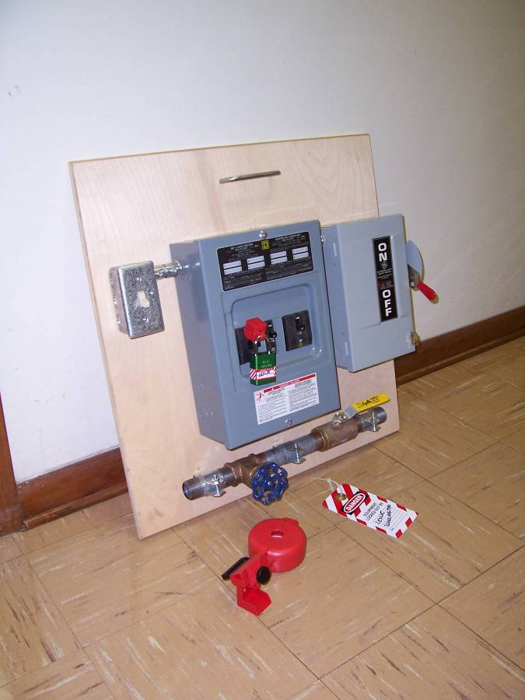
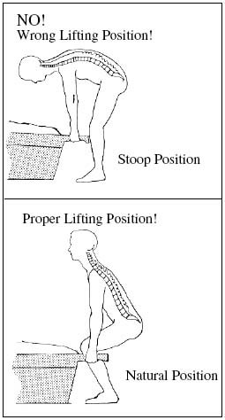
Safety & Loss Control Strategies
Avoid the hazard:

Slide 14
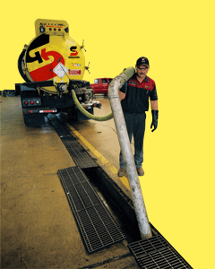
Safety & Loss Control Strategies
Transfer the hazard:

Slide 15
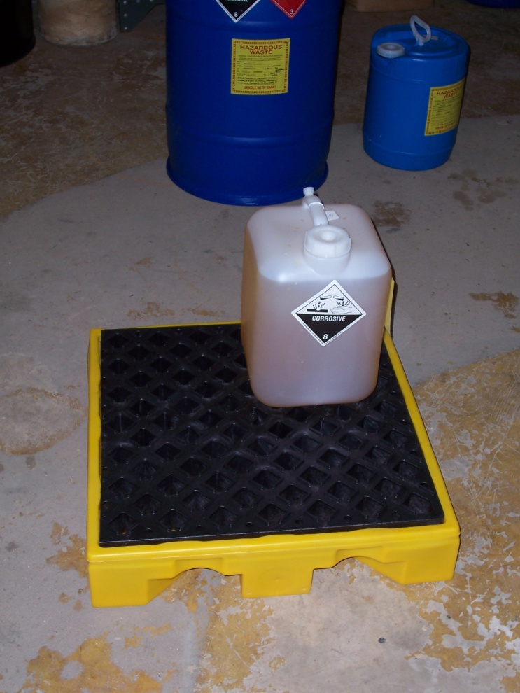
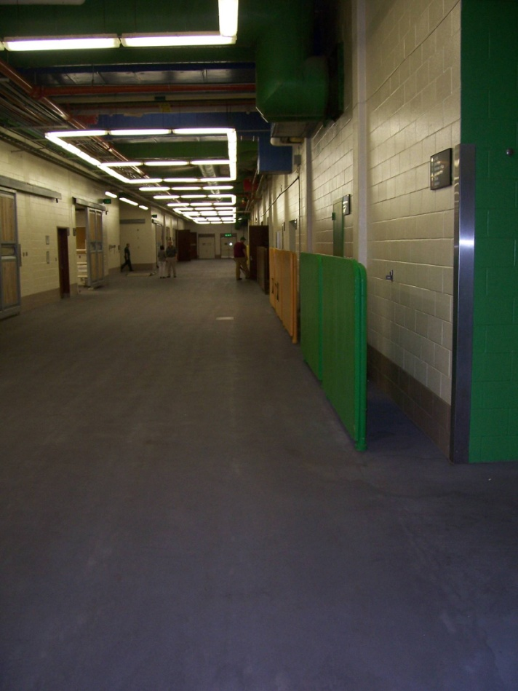
Safety & Loss Control Strategies
Control the Hazard:

Slide 16
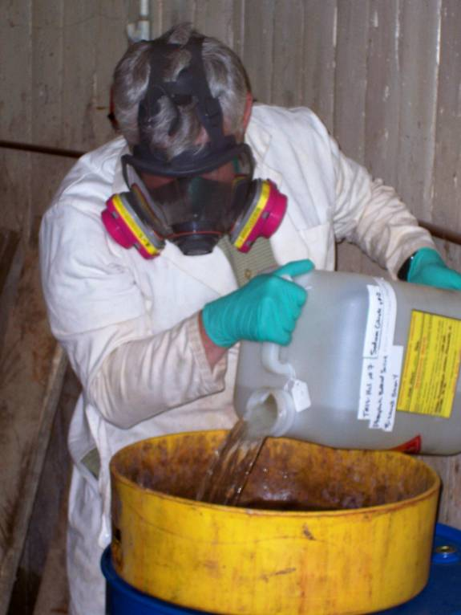
Safety & Loss Control Strategies
Guard / Protect against the hazard:

Slide 17
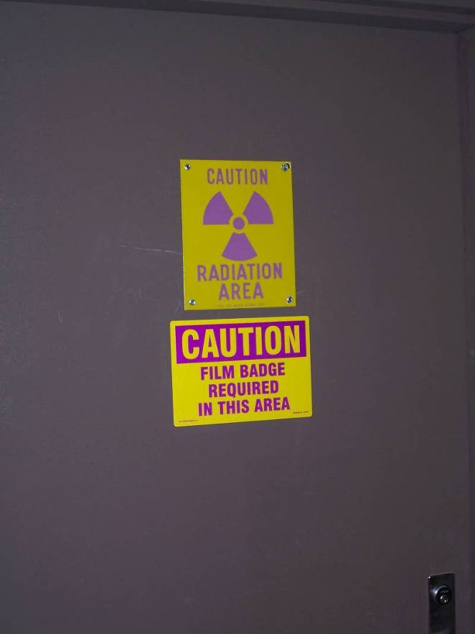
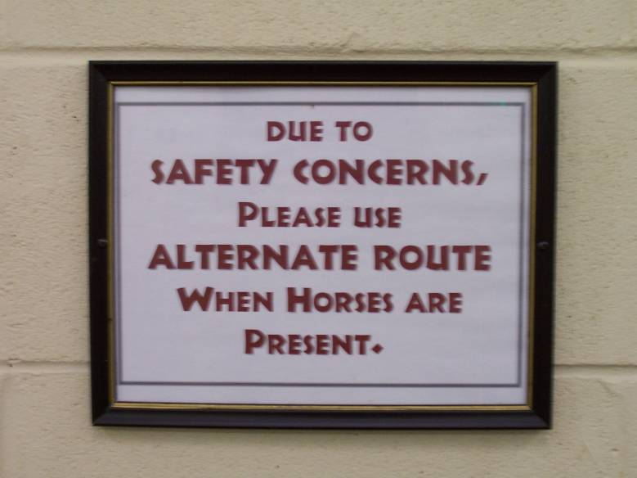
Safety & Loss Control Strategies
Warn about the hazard:

Slide 18
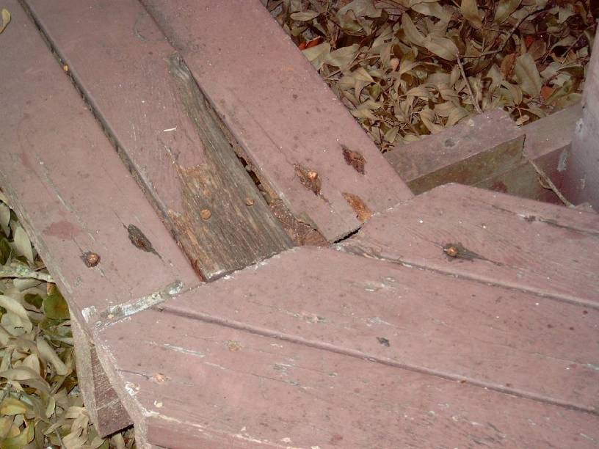
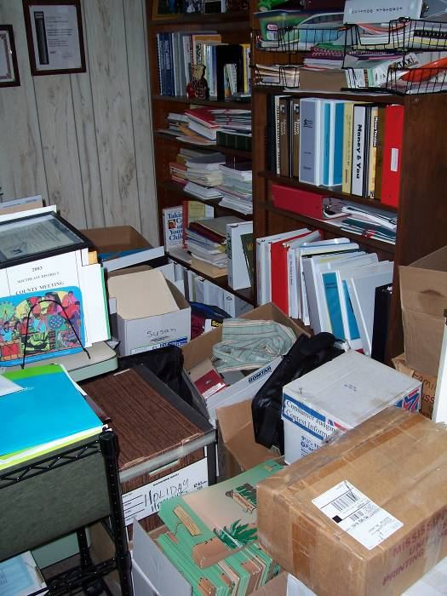
Safety & Loss Control Strategies
Eliminate / remove the hazard:

Slide 19
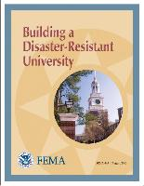
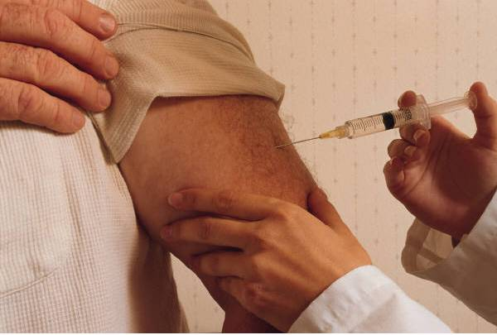
Safety & Loss Control Strategies
Strengthen against the hazard:

Slide 20
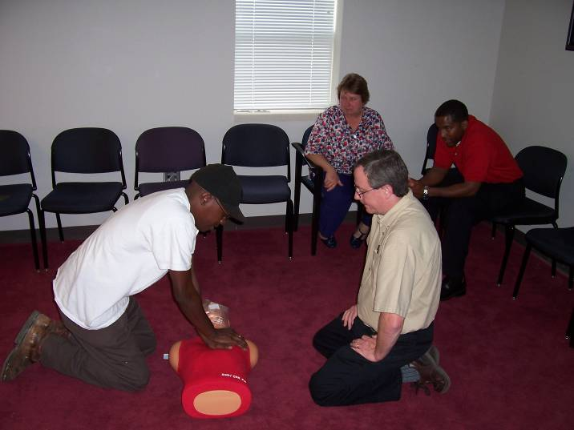
Safety & Loss Control Strategies
Prepare for recovery from hazard:
Return to Work programs are a Loss Control effort to focus on what people can do within Doctors’ limitations and transition to full duty per a schedule.

Slide 21
References
Policies
Procedures
Safety Rules
Best practices
Accreditation
Guidelines
Standards
Regulations
Laws
SACS 3.10.6: The institution takes reasonable steps to provide a healthy, safe, and secure environment for all members of the campus community.
What is the institution's safety plan? Who has administrative responsibility for health, safety and security functions? Are facilities and grounds regularly reviewed and/or tested for health and safety concerns? How does the institution ensure campus security?
Documented emergency plans, inspection reports, evacuation plans, compliance with environmental and occupational regulations?

Slide 22
Available Resources
Campus Subject Matter Experts
IHL Office of Risk Management
Campus Safety Committees
Local, state and federal agencies
Trade specific organizations
Manufacturers
Insurance personnel and programs

